Slide 1
Project 1 - Redes neuronales
Barbe Victor
Bregeon Antoine
Gaucher Pierre-louis

Slide 2
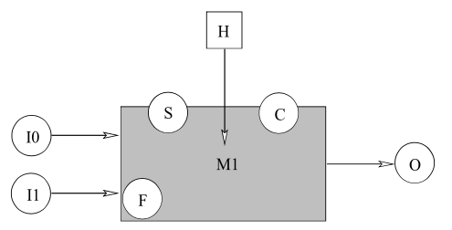
Presentation of the subject
We will take a look at a water treatment unit, with the goal of predicting some probabilities we will define using Probt
The model we will study can be schematized as so:
I0 and I1 represent the quality value of two different input water streams, O is the output quality
H is an external is an unknown external factor that may perturb the unit (external pressure, humidity …)
S in a sensor that helps to predict the unknown value of F, which is the efficiency of the unit
C is a controller used to regulate and optimize O (the quality of the output flow of water)

Slide 3
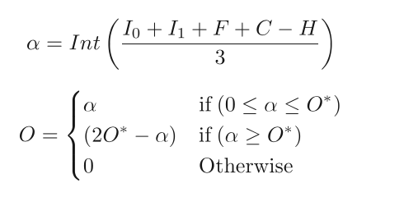
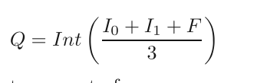

Presentation of the variables
Each of the variables described previously can take an integer value between 0 and 10, 0 being the worst value (bad quality for the water input as an example), and 10 the best.
Here is the function allowing to compute the quality of the water output O value knowing other variables (O* is the maximum value of O (quality output) that can be reached when the systems works perfectly:

Slide 4
Presentation of the questions
We will be computing the following probabilities:
P(0 | I0 = i0 I1 = i1) : The distribution of the quality of the water output knowing the specific value of the quality of the inputs flows
P(H F | O=o I1 = i1): The distribution of H F( the efficiency of the box and the outside conditions) knowing the quality value of the flow output and the quality of the first input
P(I0 | O = o I1 = i1): The distribution of the quality of the first water input knowing the quality value of the output flow and the quality of the second water input.
P(O | C = c I0 = i0 I1 = i0) : The distribution of O (the quality of the output) knowing the the value of the controller and that we have the same value for both input flows.

Slide 5
Definition of the problem
To work on the problem, we will first define the type of variable (here integer values between 0 and 10). Then we will create a variable for each of the parameters of the problem.
Then we will define the function we use to compute the water output, which was described above using alpha. It will take in parameter all the parameters in the system to compute the output flow
After that we will define the joint distribution which will take all the parameters of the system. The unknown variables will be defined as uniform laws between 0 and 10, and depending on the question the user will enter the known values

Slide 6
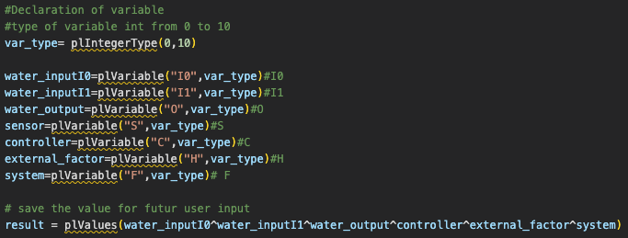
Presentation of the variables
First we define the type of the variables, here integers between 0 and 10. Then we can define the different variables that will be used in this project:

Slide 7
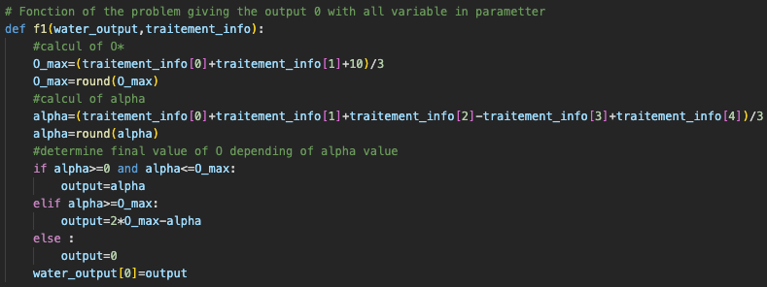
Definition of the system using a function
To compute different probabilities, we will need to define our system. Here is the function that we will use to compute different output. It takes the treatment information (water input, external conditions, the controller value and the efficiency of the unit) to output the quality of the output water flow

Slide 8

Defining unknown variables
For each question, the variables that we don’t know the value of will be described using a uniform law. The rest of the variables will indeed be using the user’s input to get the the probability

Slide 9
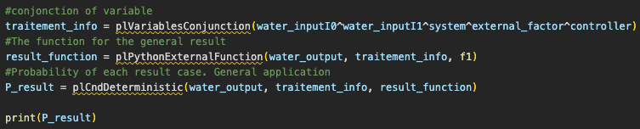

Defining the links between variables
Here we define the link between variables. We can associate our variables with plVariableConjunction, we then associate the variables with the function and the output using plPythonExternalFunction, and create the probability function using plCndDeterministic. After that, we can define our joint distribution:

Slide 10
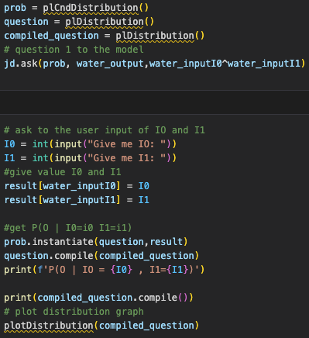
Question 1 : P(0 | I0 = i0 I1 = i1)
For the first question we want to compute the probability to get a certain value of quality output knowing both quality inputs. Now that we defined the functions and the variables, we will ask probT for the correct probability base on the information we have:

Slide 11
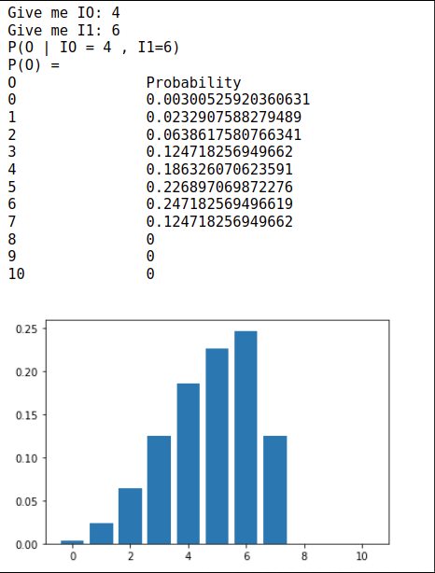
Question 1 : P(O | I0 = i0 I1 = i1)
Finally we can compute the probability of O, depending on the input for I0 and I1, and plot a graph:
For this case, the higher the quality input values are, the higher the probability of getting a good water output quality are. The graph shows the probability distribution of O.

Slide 12
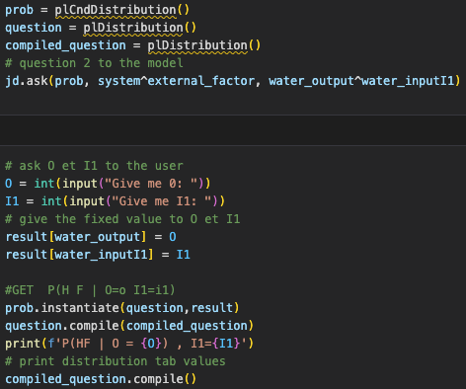
Question 2 : P(H F | O=o I1 = i1)
We want to compute the intersection of H (external conditions) and F (the efficiency of the system) knowing the output value and one of the quality of the input flows. Again we use the defined functions and ask probT:

Slide 13
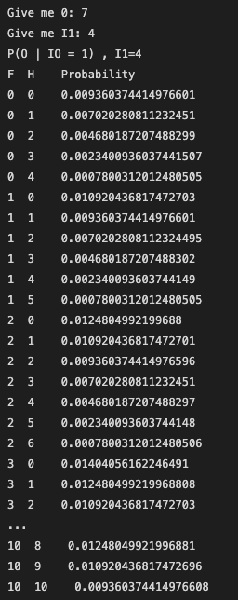
Question 2 : P(H F | O=o I1 = i1)
For question 2 we get the following output for H F:
Here, since H represents the perturbation of the system and F the efficiency, if we get a good water output and a bad water input as an example, we will most likely have a good F value and a low perturbation as an example.

Slide 14
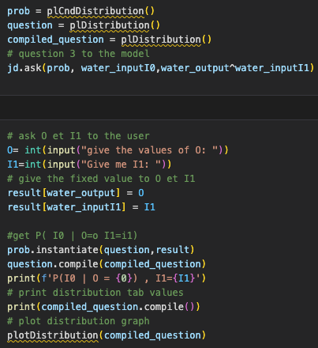
Question 3 : P(I0 | O = o I1 = i1)
We want to compute the probability distribution of the first input flow quality knowing the output flow quality and the quality of the other water input flow.

Slide 15
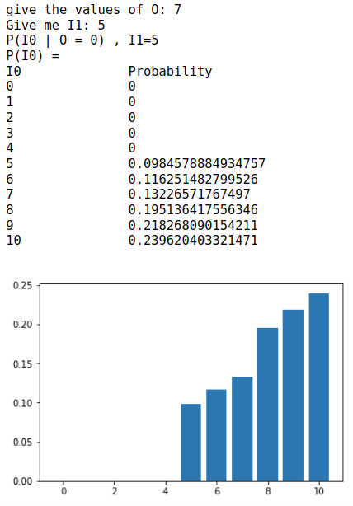
Question 3 : P(I0 | O = o I1 = i1)
We get the following output for I0, and we plot a graph of the probability distribution of I0
Here the higher the output value is and the lower the second output value is, the higher the value of IO will be distributed

Slide 16
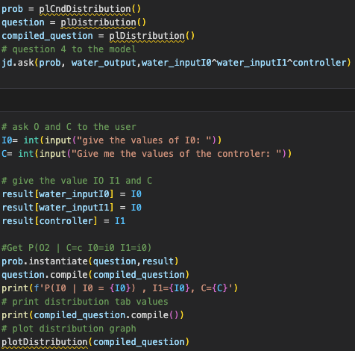
Question 4 : P(O | C = c I0 = i0 I1 = i0)
We want to compute the probability distribution of the water output knowing the controller value, and that both water inputs have the same quality:

Slide 17
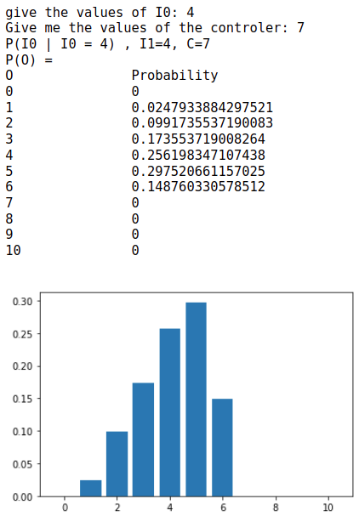
Question 4 : P(O | C = c I0 = i0 I1 = i0)
We want to know the quality output knowing the value of the controler and the quality of the inputs. We get the following output, and this graph for the probability distribution:

Slide 18
Conclusion
To conclude, we could create a program using Probt that is capable of computing the probability distribution of a variable knowing other factors and using uniform distribution for unknown variables.
We can get the probability distribution of one of the parameters of the water treatment unit, depending on fixed values of some variables.

